Slide 1
Lesson 1-2: Points, Lines, & Planes
http://www.pearsonsuccessnet.com/snpapp/learn/navigateIDP.do?method=vlo&internalId=131012100000016&isHtml5Sco=false&fromTab=DONETAB
Point | part of a line that consists of two endpoints and all points in between
Line | two rays that share the same endpoint and form a line
Plane | points that lie on the same line
Collinear | indicates a location and has no size
Coplanar | part of a line that consists of one endpoint and all points on one side of that endpoint
Segment | points and/or lines that lie in the same plane
Ray | is represented by a straight path that extends in two opposite directions without end, has no thickness and contains an infinite amount of points
Opposite Rays | a set of points that two or more figures have in common
Postulate or Axiom | is represented by a flat surface that extends without end, has no thickness, and contains an infinite amount of lines
Intersection | an accepted statement of fact

Slide 2
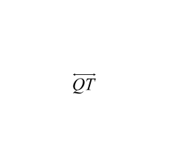
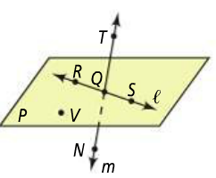
1a. What are two other ways to name ?
1b. What are two other ways to name plane P?
1c. What are the names of three collinear points? Four coplanar points?
2a. What are the names of the segments
in the figure at the right?
2b. What are the names of the rays in the figure?

Slide 3
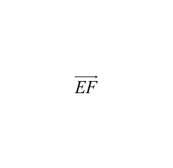
2c. Which of the rays in 2b are opposite rays?
2d. and form a line. Are they opposite rays? Explain.

Slide 4
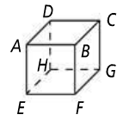
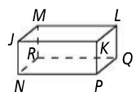
3a.
3b.
3c.

