Slide 1
Lesson 1-3/1-4: Measuring Segments/Measuring Angles
Coordinate | a point that divides a segment into two congruent segments
Distance | greater than zero and less than 90 degrees
Congruent | 180 degrees
Midpoint | the absolute value of the difference of the coordinates
Bisector | the absolute value of the difference of real numbers paired with rays when using a protractor
Angle | the rays of an angle
Sides | the real number that corresponds to a point
Vertex | 90 degrees
Measure | the measurement is the same
Acute | greater than 90 and less than 180 degrees
Right | a point, line, ray, or segment that intersects at the midpoint
Obtuse | the endpoint of an angle
Straight | formed by two rays with the same endpoint
1a.

Slide 2
1b.
1c. Do practice problems 1 & 7 on 1-3 WS.
2a.
2b.
2c. Do practice problems 6 & 10 on 1-3 WS.

Slide 3
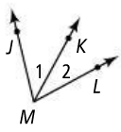
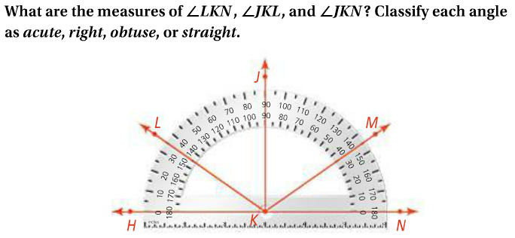
3a.
3b.
3c. Do practice problems 1, 2, & 3 on 1-4 WS.
4a.

Slide 4
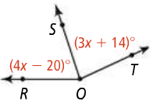
4b. Do practice problems 4 & 5 on 1-4 WS.
5a.
5b.
5c. Do practice problem 15 on 1-4 WS.
Do remainder of problems on 1-3/1-4.

