Slide 1
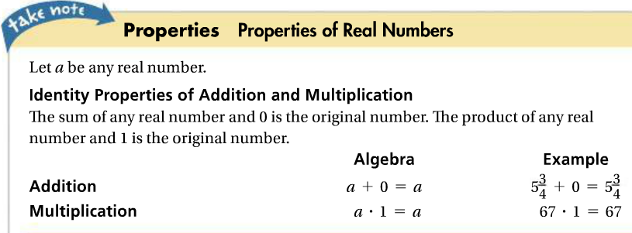
Lesson 1-4: Properties and Parts of Expressions
1. Which identity property does this satisfy and why?
1b. Which identity property does this satisfy and why?

Slide 2
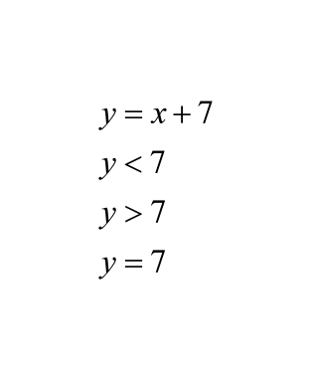
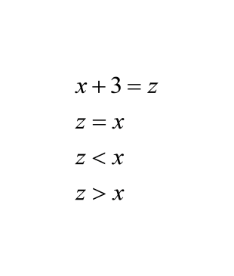
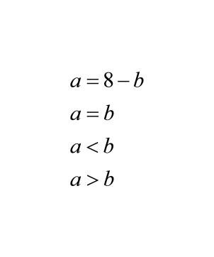
Move to engage NY Lesson 7.
2.
2b.
2c.

