Slide 1
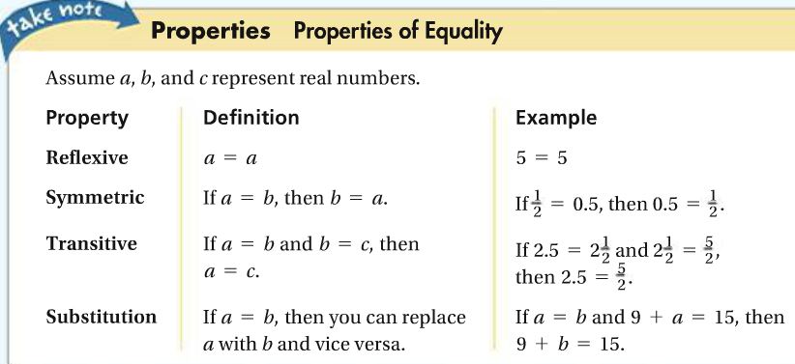
Lesson 1-4: Solving Equations
An equation is a statement that two expressions are equal.

Slide 2
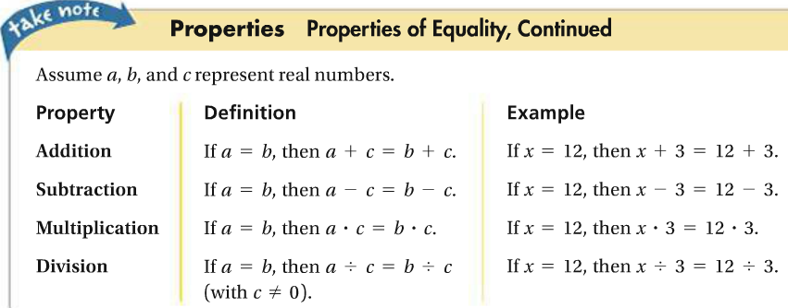
1. Solve and justify each step.
2. Solve and justify each step.

Slide 3
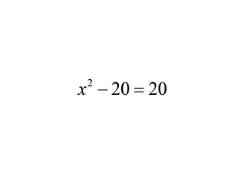
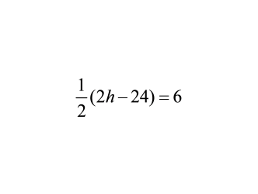
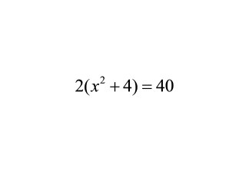
3. Solve.
4. Solve.
5. Solve.
You do 1-3 on WS.

Slide 4
10.
11.
12.
You do 14-15 on WS.
Assignment: 4-8 & 16-19 on WS.

