Slide 2
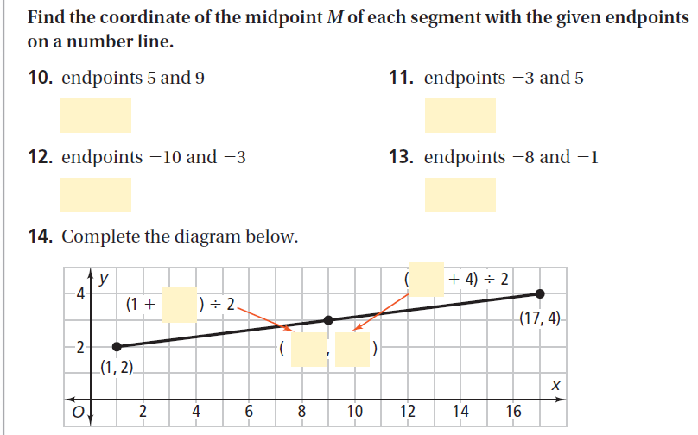
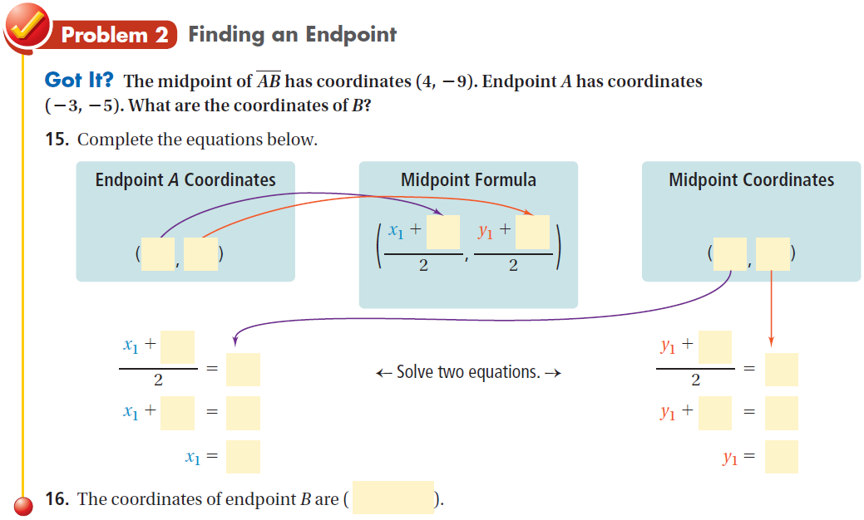
Do practice problems 1 & 5 on WS.
Do practice problem 10 on WS.

Slide 3
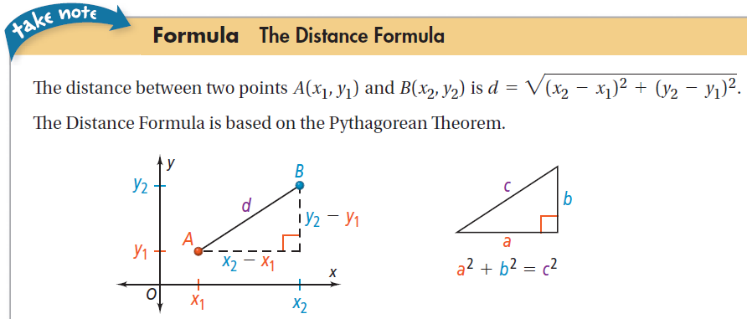
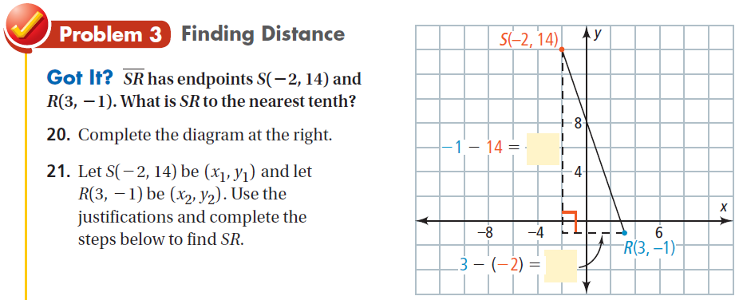
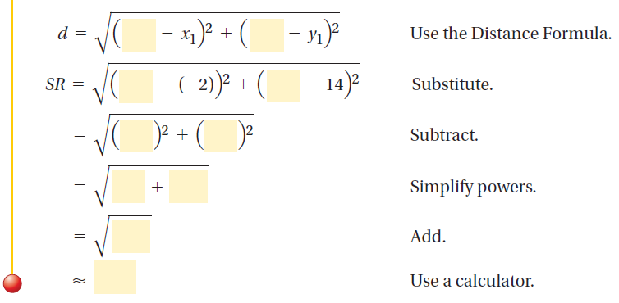

Slide 4
Do practice problems 15 & 16 on WS.
Do practice problem 20 on WS.
Assignment: Remainder of WS.

