Slide 1
1-7: The Distributive Property
1. Simplify the expression.
1a. Simplify the expression.
1b. Do problems 1, 10, 11 on WS.

Slide 2
A fraction bar indicates division. You can use the distributive property to rewrite some fractions as sums or differences.
2.
2a.
2b. Do problems 17, 19 on WS.

Slide 3
3.
3a.
3b. Do problems 25, 26, 31 on WS.

Slide 4
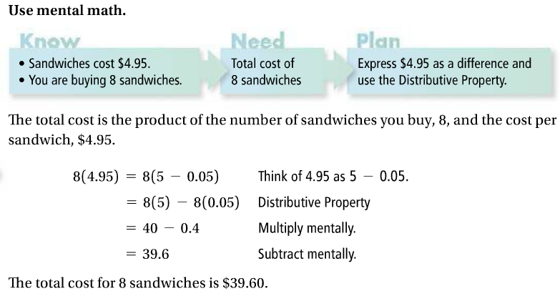
4.
4a.
4b. Do problems 41, 43 on WS.

Slide 5
In an algebraic expression, a term is a number, a variable, or the product of a number and one or more variables. A constant is a term that has no variable. A coefficient is a numerical factor of a term. Rewrite expressions as sums to identify these parts of an expression.
Like terms have the same variable factors.
5.
5a.
5b. Do problems 44, 46, 50 on WS.

