Slide 1
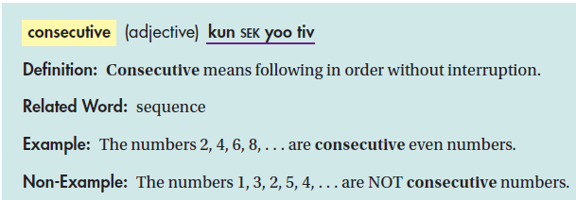
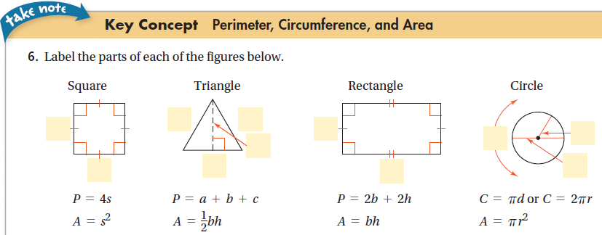

Slide 2
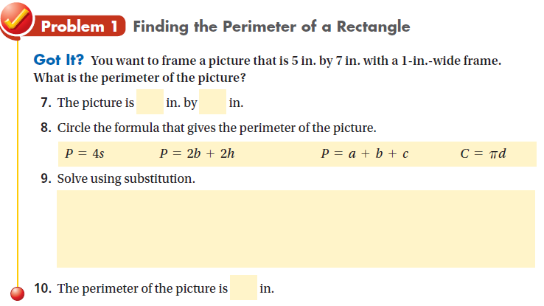
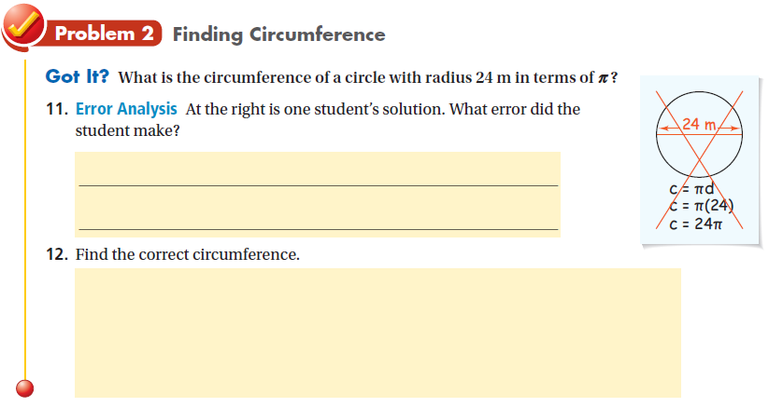
Do practice problems 1 & 2 on WS.
Do practice problems 5 & 6 on WS.

Slide 3
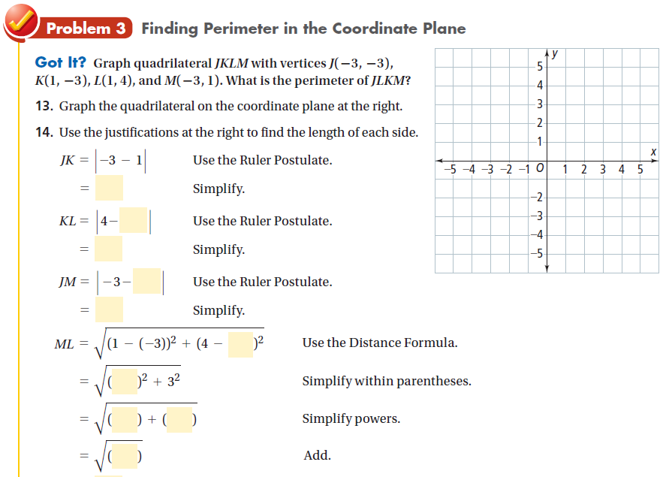
Do practice problem 9 on WS.
Problem 4: Do practice problem 11 on WS.

Slide 4
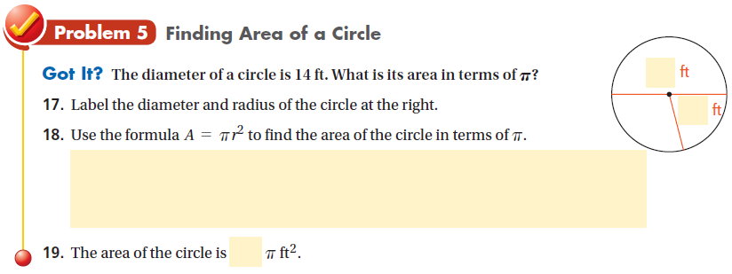
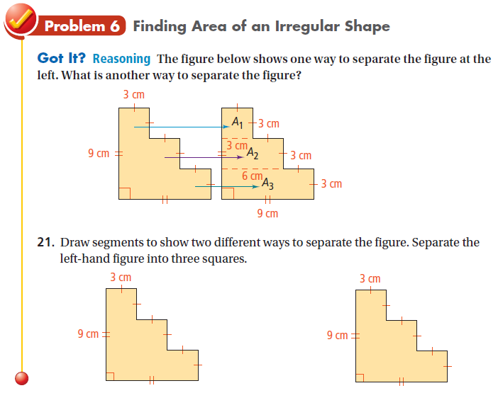
Do practice problem 17 on WS.
Do practice problem 24 on WS.
Circle Song 2.
Assignment: Remainder of WS.

