Slide 1
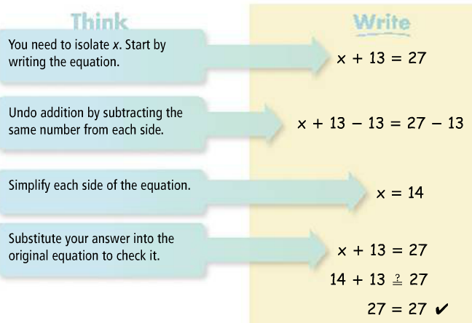
2-1 & 2-2: Solving One & Two Step Equations
Addition and Subtraction Properties of Equality allow you to add or subtract the same amount from both sides of the equation and for it to still be equal.
In order to solve an equation, you must isolate the variable so that it has a coefficient of 1 and is by itself on one side of the equation. You do this by performing inverse operations (operations that are the opposite of what is currently being done).
1.

Slide 2
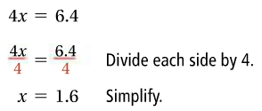
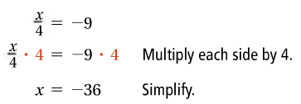
1a.
1b.
1c.

Slide 3
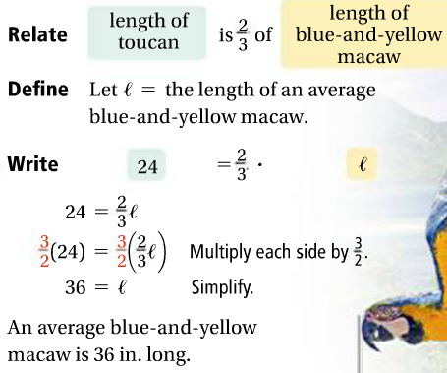
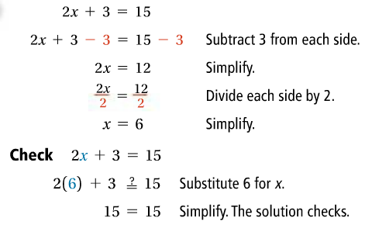
1d.
1e.
2.

Slide 4
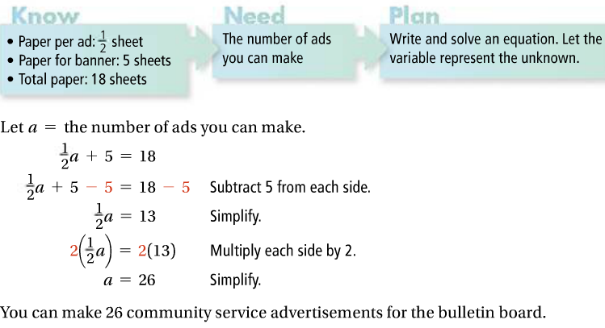
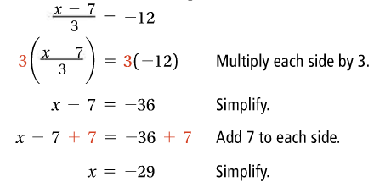
2a. Do problems 2, 7 on WS.
2b.
2c. Do problem 16 on WS.
2d.
2e. Do problems 18, 20 on WS.

