Slide 1
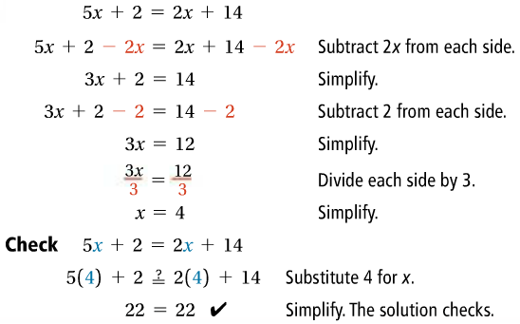
2-4: Solving Equations with Variables on Both Sides
1.
1a.

Slide 2
1b.
1c.

Slide 3
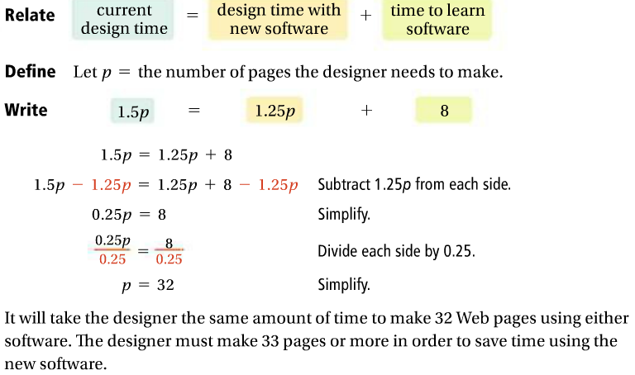
2.
2a.

Slide 4
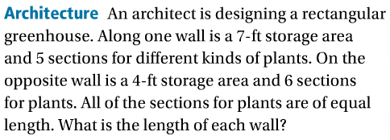
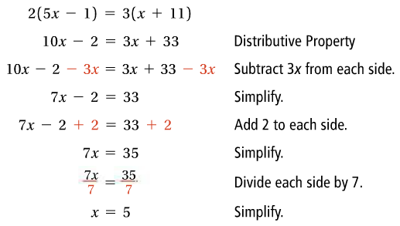
2b.
2c.
3.

Slide 5
3a.
3b.
3c.

Slide 6
4.
4a.
4b.
4c.

