Slide 1
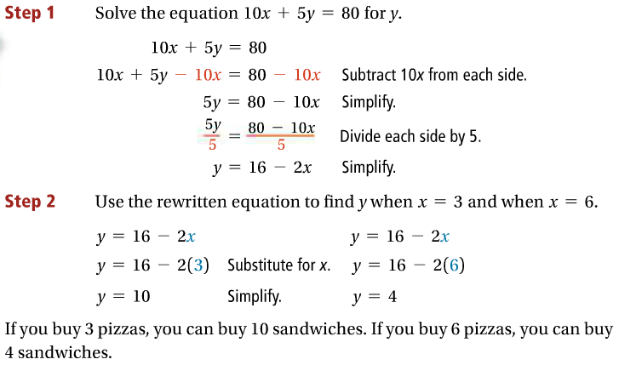
2-5: Literal Equations and Formulas
literal equation - an equation with two or more variables.
1.

Slide 2
1b.
1c.
2.
2a.

Slide 3
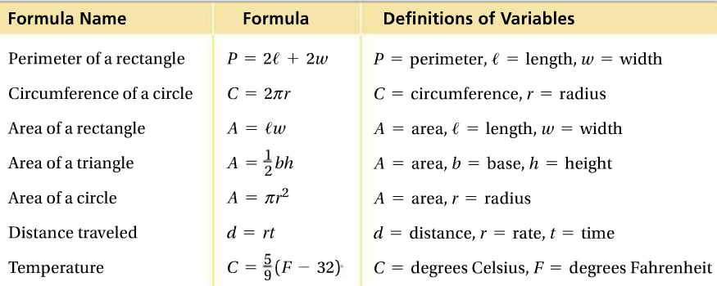
2b.
2c.

Slide 4
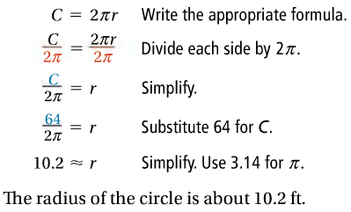
3.
3a.
3b.

Slide 5
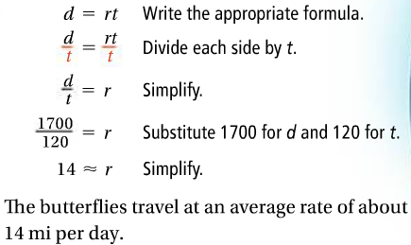
4.
4a.
4b.

