Slide 1
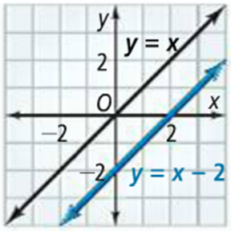
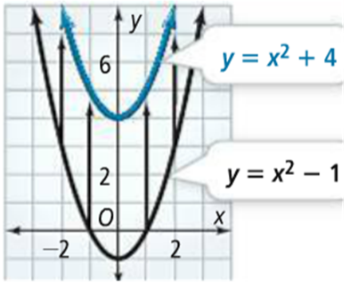
2-6: Families of Functions
Each linear function is a transformation of the function y=x. y=x is the parent linear function.
There are different transformations of lines, just like there are transformations of figures. For the parent function f(x), f(x) + or - k is a vertical translation. f(x + or -h) is a horizontal translation.
Adding k shifts the graph up, subtracting k shifts the graph down.
Subtracting h shifts the graph right, adding h shifts the graph left.
1a.
1b.

Slide 2
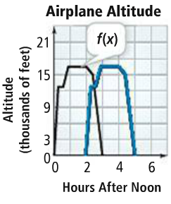
1c. Do problems 1, 3, 6 on WS.
2a.
2b.
2c. Do problem 8 on the WS.

Slide 3
A reflection flips the graph of a function across a line, such as the x- or y-axis. Just as in reflecting a figure, each point is reflected in the same distance from the line of reflection as the corresponding point of the original.
If reflecting a function over the y-axis the parent function f(x) becomes
f(-x). For a reflection in the x-axis the parent function becomes -f(x).
3a.
3b.
3c. Do problems 15, 16 in WS.

Slide 4
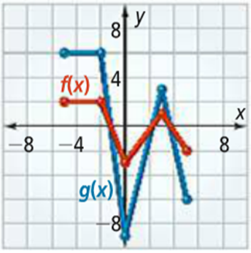
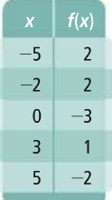
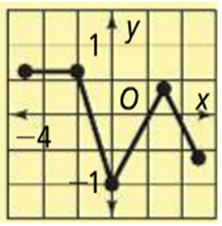
A vertical stretch of the parent function f(x)=af(x) with a being greater than 1. A vertical compression of the parent function f(x)=af(x) with a being between 0 and 1.
4a.
4b.
4c. Do problems 11, 12 on WS.
3rd period do also, 2, 4, 7, 9.

