Slide 1
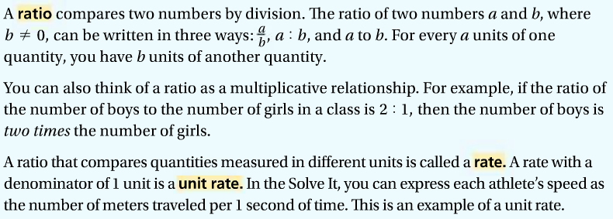
2-6: Ratios, Rates, and Conversions
1.
1a.

Slide 2
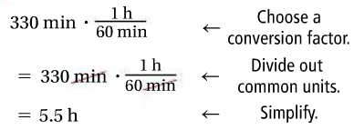
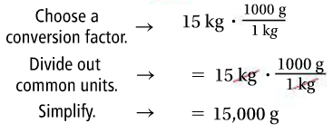
1b.
2.
2a.

Slide 3
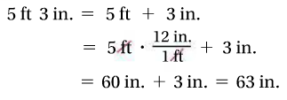
2b.
2c.
3.

Slide 4
3a.
3b.

Slide 5
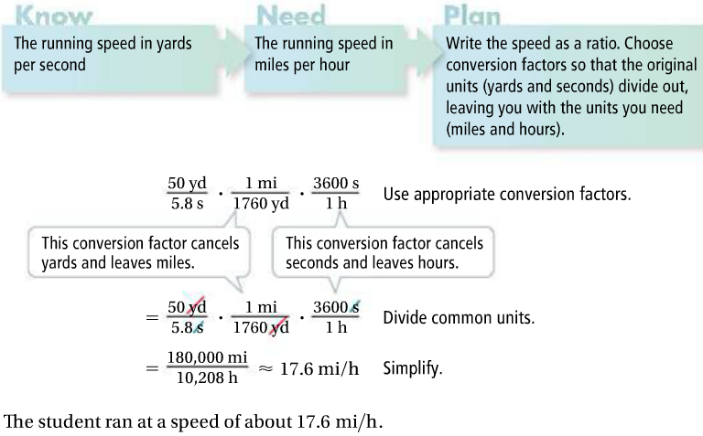
4.
4b.

