Slide 1
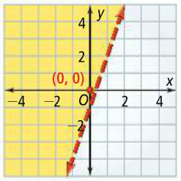
2-8: Two Variable Inequalities
A linear inequality is an inequality in two variables whose graph is a region of the coordinate plane bounded by a line. This line is the boundary of the graph, separating it into two half-planes in which one of them consists of the solutions to the inequality.
Test point - a point that is picked on the graph, other than on the boundary, in order to determine which half-plane to shade. If the point satisfies the inequality then that is the half to shade.
1a.

Slide 2
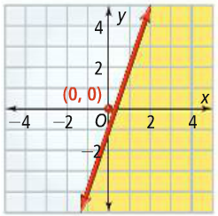
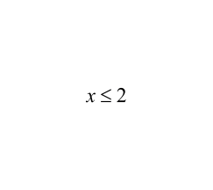
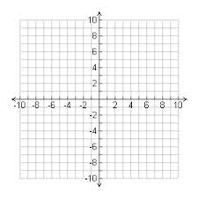
1b.
1c. Do problems 1, 2 on WS. Use the top equation only.
2a. What is the graph of ?

Slide 3
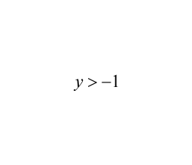
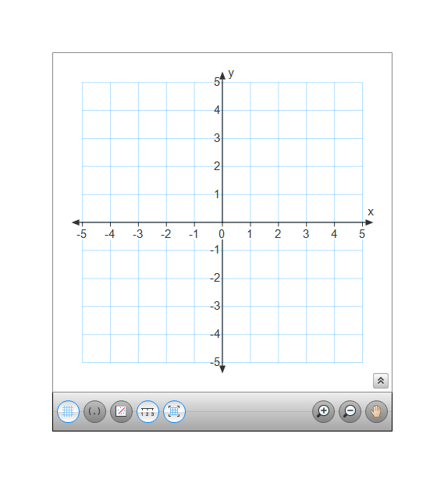
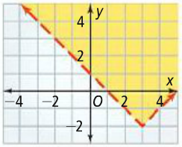
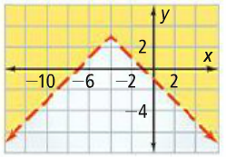
2b. What is the graph of ?
true.
Shade same
side
2c. Do problems 3 & 5 on WS. The top equations only.
3a.
Y-intercept
3b.
3c. Do problems 10 & 12 on WS.
Assign problems 4, 6-8 on WS.

