Slide 1
Lesson 3-2 & 3-5: Solving Two & Three Variable Systems Algebraically
1a. Solve by substitution or elimination
1b.
1b. Do problems 1, 2, 3 on WS.

Slide 2
1c.
1d.
3b. Do problems 21, 22, 23 on WS.
1e. Do problems 1 & 2 on WS.

Slide 3
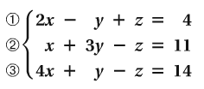
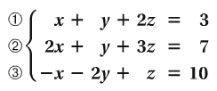
2a.
2b.

Slide 4
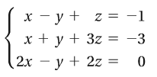
2c.
2d.
2e. Do problems 7 on WS.
Assign complete WS.

