Slide 1
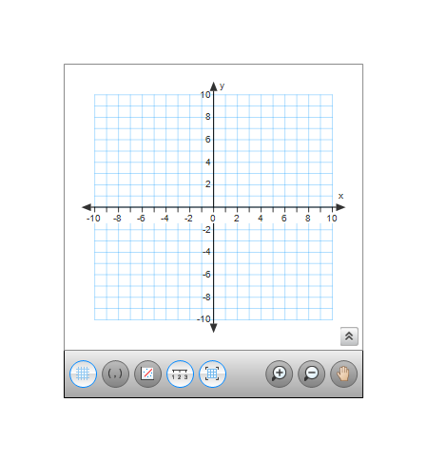
4-1: 2nd Day Quadratic Functions & Transformations
4a.

Slide 2
4b.
4c.
What steps transform the following functions.
4d.

Slide 3
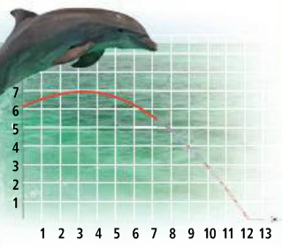
5a.
5b.
5c.
5d.

