Slide 1
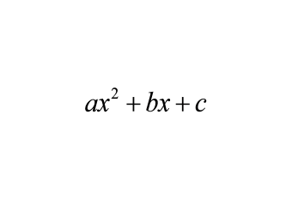
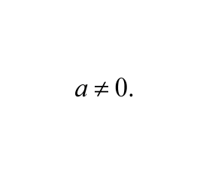
4-1: Quadratic Functions & Transformations
Discuss the definitions of the following words with your seat partner and be prepared to share with the class.
1. Parabola
2. Quadratic Function
3. Axis of Symmetry
Parabola - the graph of a quadratic function.
Quadratic Function - a function in the form of in which
Axis of Symmetry - a line that divides the parabola into two mirror images.

Slide 2
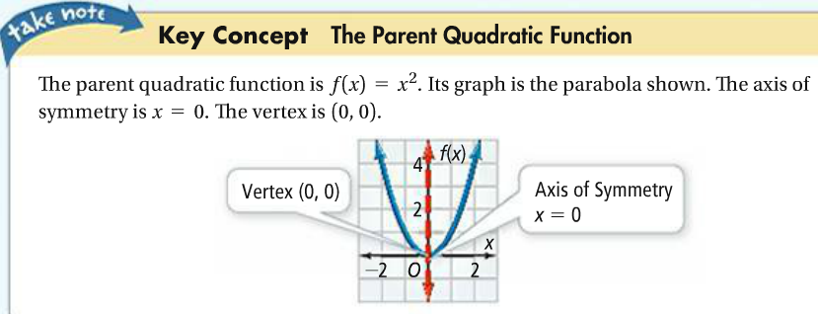

Slide 3
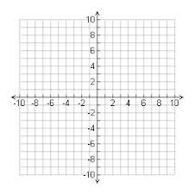
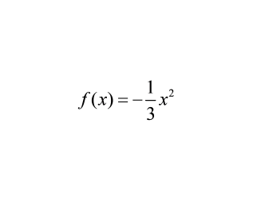
1a.
1.b. What is the graph of ?

Slide 4
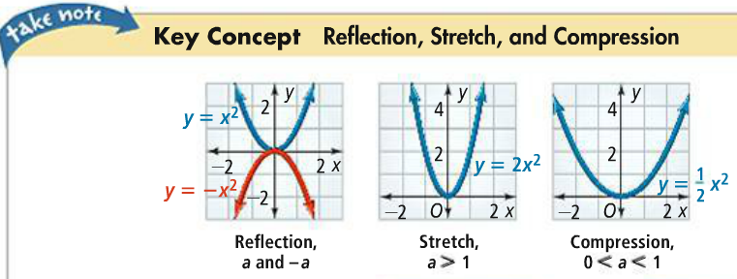
1c.

Slide 5
2a.
2b.
2c.

Slide 6
3a.
3b.
3c.

