Slide 1
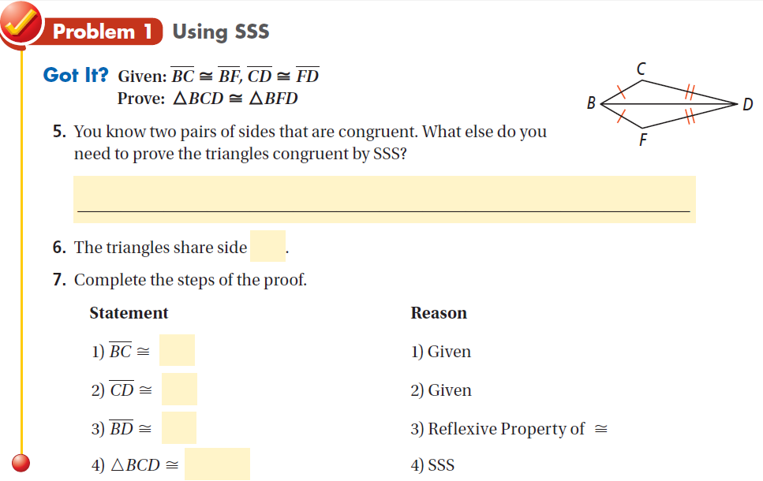

Slide 2
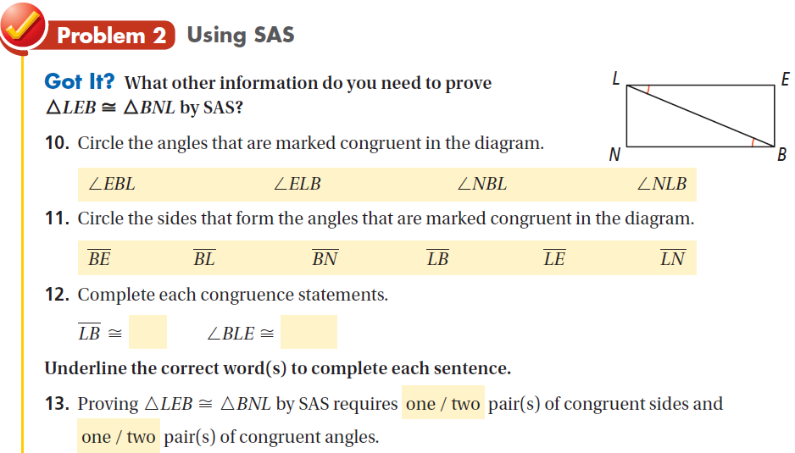

Slide 3
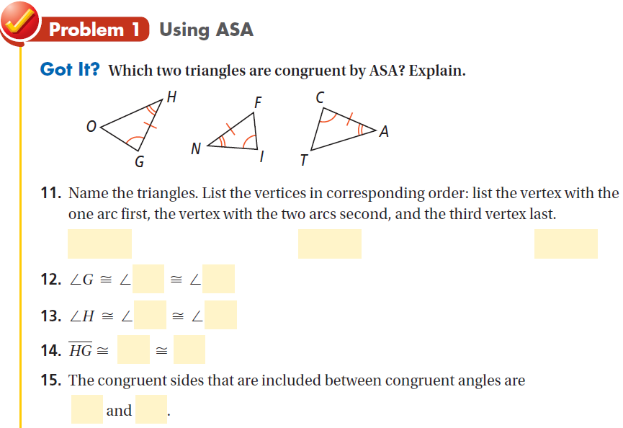
; we only know 3 sides
the angle we know is not
included in the same sides

Slide 4
