Slide 1
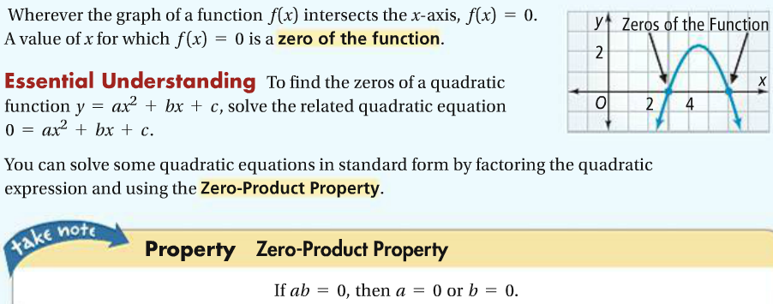
Lesson 4-5: Quadratic Equations
1a.

Slide 2
1b.
1c. Do practice problems 1 & 4 on WS.
2a.

Slide 3
2b.
2c. Do practice problems 2 & 3 on WS.
3a.

Slide 4
3d.
3e. Do practice problems 17 & 24 on WS.
Assignment: 5-8

