Slide 1
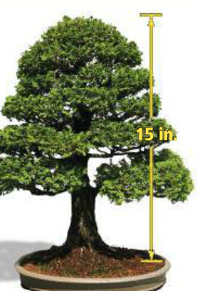
Lesson 7-1: Ratios & Proportions
Ratios | the middle two numbers in a proportion
Extended Ratios | an equation that states two ratios are equal
Proportions | a comparison of two quantities by division
Means | the first & last numbers in a proportion
Extremes | compares three or more numbers
1a.
1b.
1c. Do practice problems 1 & 2 on WS.

Slide 2
2a.
2b.
2c. Do practice problem 5 on WS.

Slide 3
3.
3.
3c. Do practice problems 8 & 10 on WS.

Slide 4
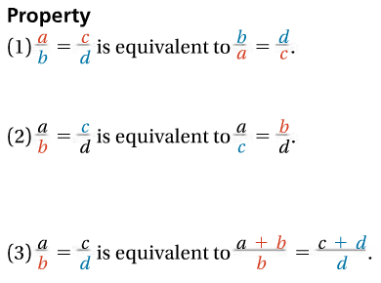
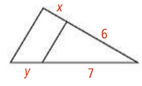
Key Concept: Properties of Proportions
Let a = 2, b = 3, c = 4, d = 6
Use above numbers to show examples.
4a.
4b. Use the same diagram to show the other two properties.
4c. Do remainder of 1-15 on WS.

