Slide 1
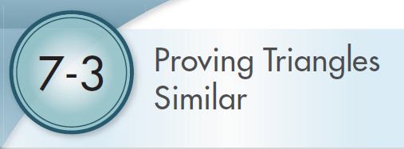
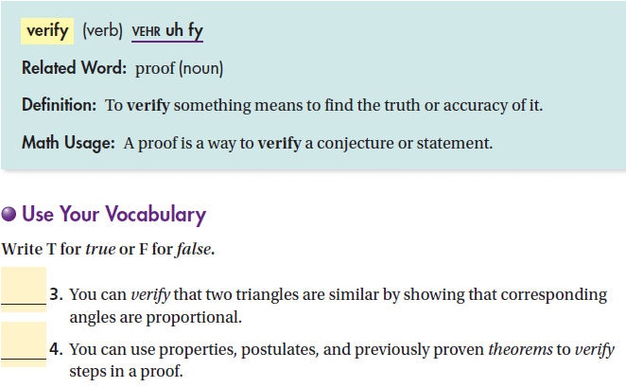

Slide 2
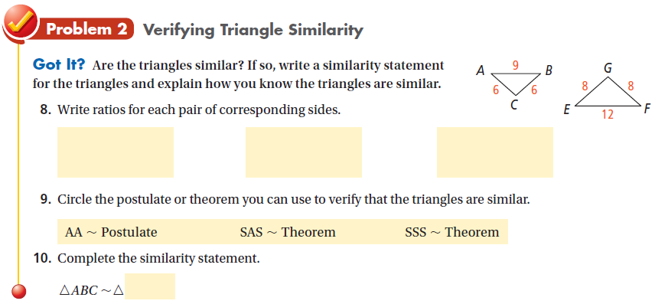
Do practice problems 1 & 2 on WS.

Slide 3
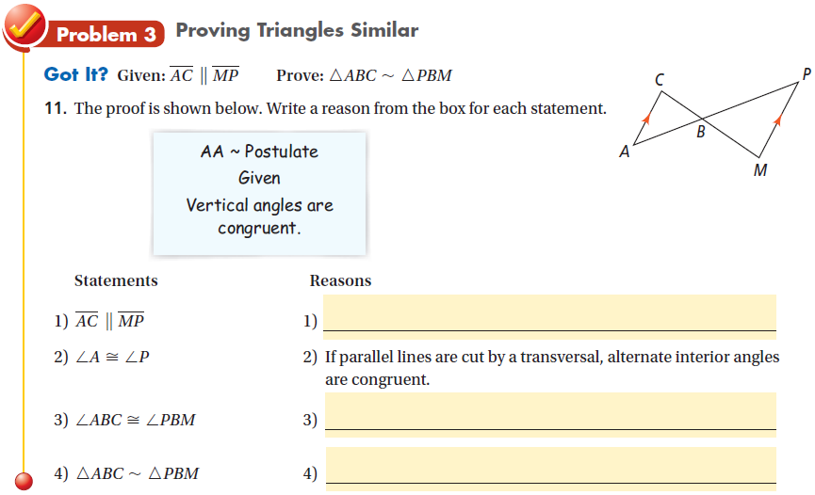
We do practice problem 5 on WS.

Slide 4
Set up the proportion and solve for x.
Do practice problem 8 on WS.

