Slide 1
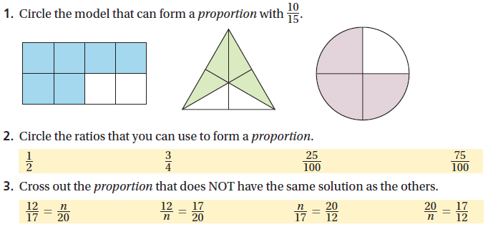

Slide 2
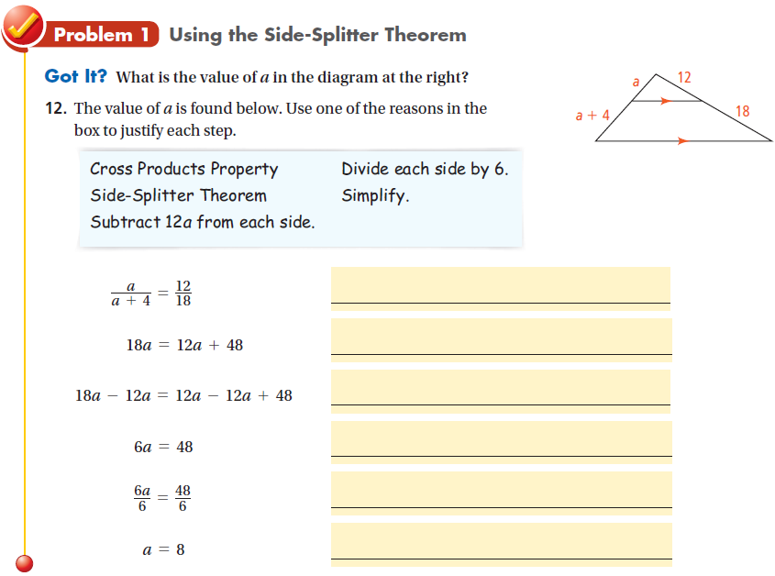
Do practice problems 1 & 2 on WS.

Slide 3
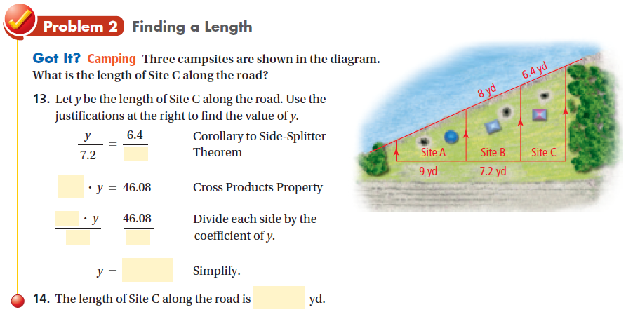
Do practice problem 7 on WS.
Do practice problem 11 on WS.

Slide 4
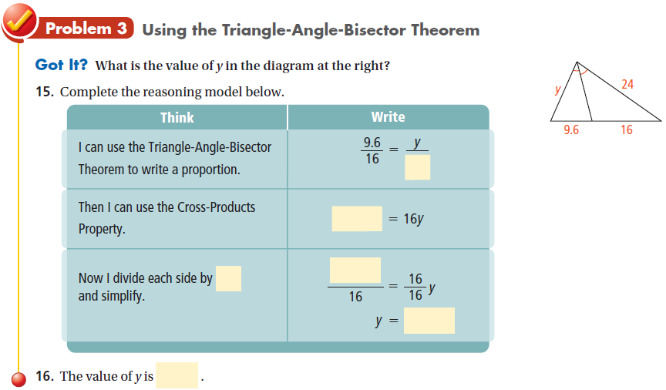
Do practice problem 10 on WS.
Do remainder of WS.

