Slide 1
8-2: Multiplying & Factoring
1.
1a.
1b. Do problems 1, 4, 7 on WS.

Slide 2
2.
2a.
2b. Do problems 16, 19, 22 on WS.

Slide 3
3.
3a.
3b. Do problems 31, 34, 37 on WS.

Slide 4
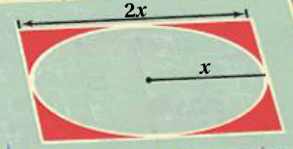
4.
4a.
4b. Do problems 49, 50 on WS.

