Slide 1
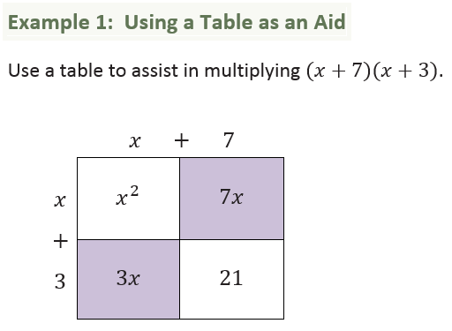
Factoring Polynomial Expressions

Slide 2
1.
2.
3.

Slide 3
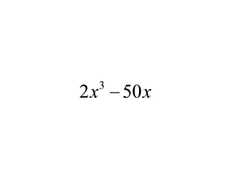
4.
Example 2: Quadratic Expressions
If the leading coefficient for a quadratic expression is not 1, the first step in factoring should be to see if all the terms in the expanded for have a common factor.
Then, after factoring out the GCF, it may be possible to factor again.
Factor the following expressions.
5.

Slide 4
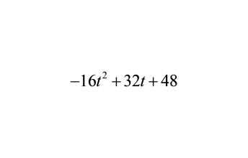
6.

