Slide 1
Geometry A Final Review
1. Match the vocabulary words to their definition.
a. all points on a line AB and containing all the points in between AB
b. all points on a line in which one point is the same as one on line AB
c. all points on a line beginning with A and continuing infinitely in one direction and containing B
d. a line that is in the same plane as line AB with the same slope so that it never intersects with line AB
A. ray AB
B. segment AB
C. a line that is parallel to line AB
D. a line that intersects line AB
2. Name the properties of a translation.

Slide 2
3. If (3,4) and (-1,3) are two adjacent vertices of a triangle, what is the perimeter of the triangle?
4. Describe the properties of a rotation.
5. Describe the properties of congruent triangles.

Slide 3
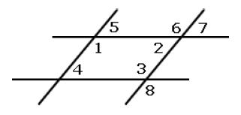
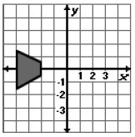
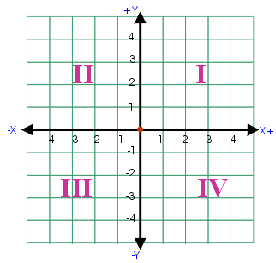
6. How can we show that angle 2 and angle 4 are congruent by using properties of parallel lines?
7. What do we know about the opposite sides of a parallelogram.
8. If the following figure is rotated 45 degrees clockwise about the origin and then reflected across the x-axis, would it end up in Quadrant I, II, III, or IV?

Slide 4
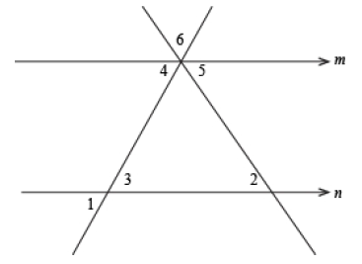
9. Which two angles inside the triangle add up to equal angle A?
10. Name two angles that must be congruent in order to prove that lines m & n are parallel?

Slide 5
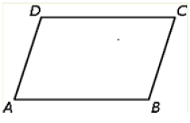
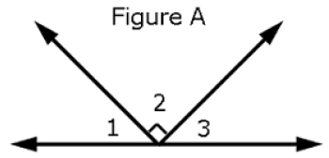
11. If ABCD is a parallelogram, name all the congruent sides & angles, and all the supplementary angles.
12. Name any two angles that are supplementary?
13. Using the same figure from #12, name any two angles that are complementary?

Slide 6
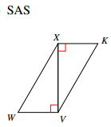
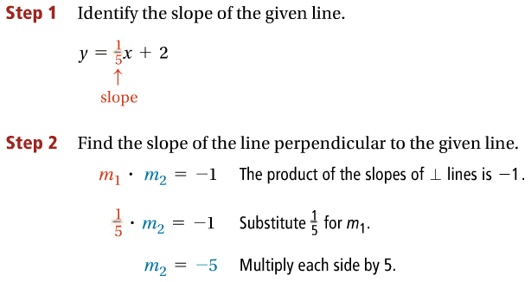
14. If a figure is dilated, is it a rigid motion? If not, what parts will change from the pre-image to the image?
15.
16.

Slide 7
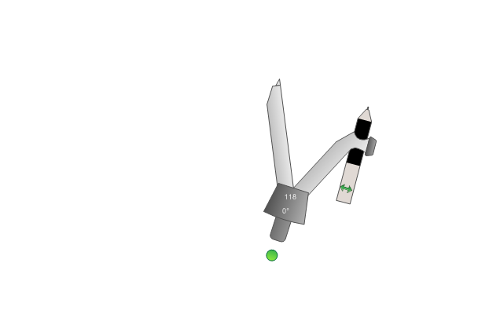
17.
18. Copy the given angle and construct it's angle bisector and describe the steps taken for each.

Slide 8
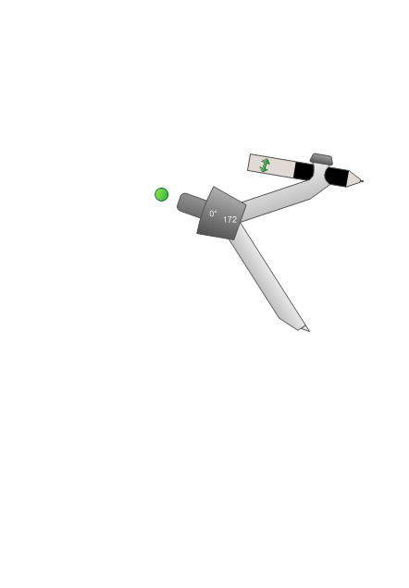
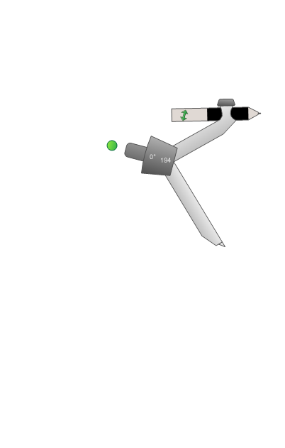
19. Construct a perpendicular and describe the steps taken.
20. Draw the line of reflection between the two objects.
21. What is the formula to rotate a figure 90 degrees about the origin?

