Slide 1
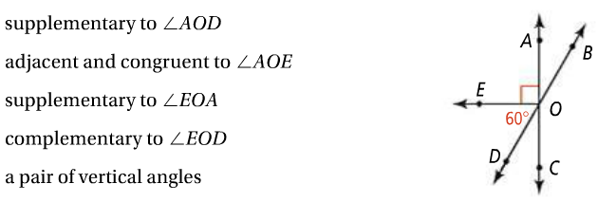
Quiz 2 Review Page 1
1.
2.
3.
4.
5.
6.

Slide 2
Quiz 2 Review Page 2
Find the distance between the two points. Put into simplest radical form.
7.
8.

Slide 3
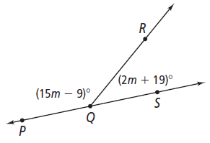
Quiz 2 Review Page 3
9.
10.

Slide 4
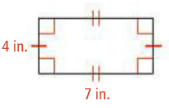
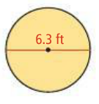
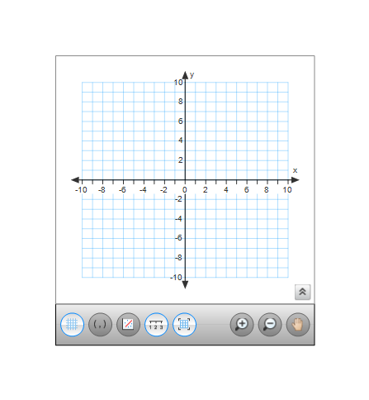
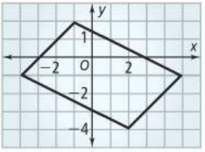
Quiz 2 Review Page 4
11.
12.
13.

