Slide 1
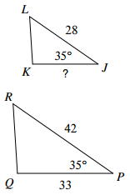
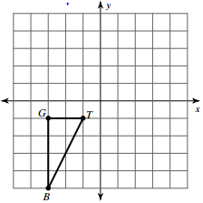
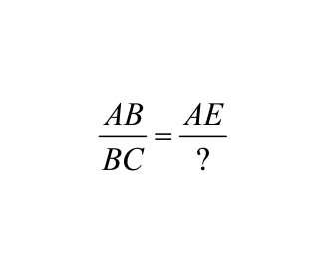
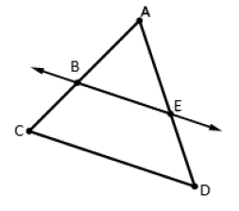
Geometry B Final Review
1.
2. What is the length of segment GT after a dilation of 2?
3. To prove the Triangle Proportionlity Theorem fill in the blank.

Slide 2
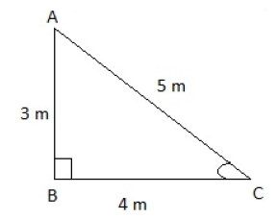
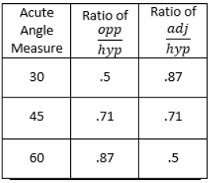
4. A movie projector positioned 40 feet from a screen projects an image that is 10 feet wide. How wide will the image be if the screen is positioned 50 feet from the projector?
5. Using the table at the right, is the angle measurement of angle C less than 30 degrees, between 30 and 45 degrees, between 45 and 60 degrees, or greater than 60 degrees?
6. The cosine of 80 degrees is the same as the sine of what degree?

Slide 3
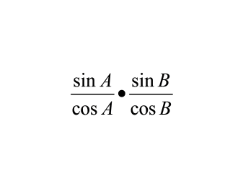
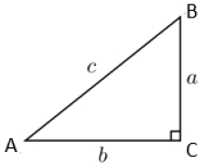
7. Triangle ABC and its side lengths are shown. What is
?
8. An airplane takes off at an angle of 12 degrees and needs to clear a tower that is 225 ft tall. How far away from the tower does the plane need to be in order to take off? Round your answer to the nearest foot.
9. Identify the center and the radius of a circle with the following equation.

Slide 4
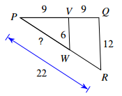
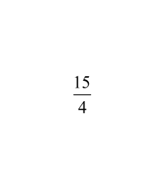
10. Find the missing side length.
11. If the x-coordinate of a point is , what is the mixed number?
12. What transformation would be used to show that two circles are similar?

Slide 5
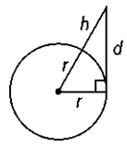
13. A is the center of the circle and D is another point on the circle, making segment BC the diameter. Describe the difference between angle BAD and angle BCD.
C
A
B
D
14.

Slide 6
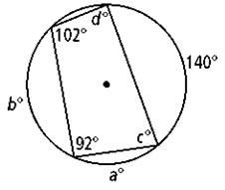
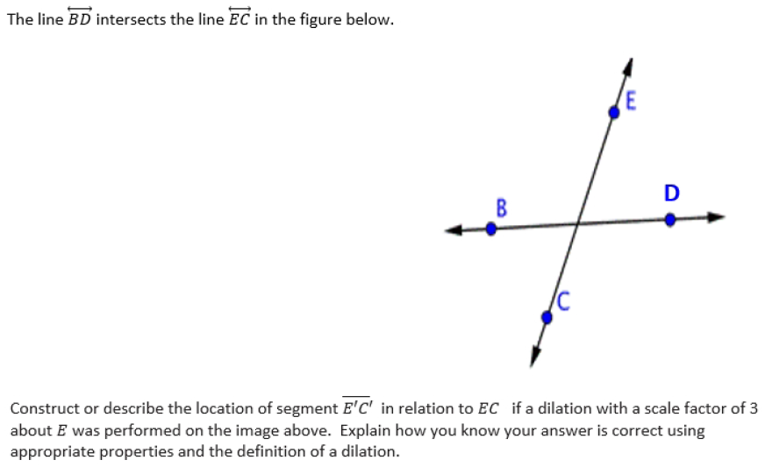
15. What is the value of c?
16.

Slide 7
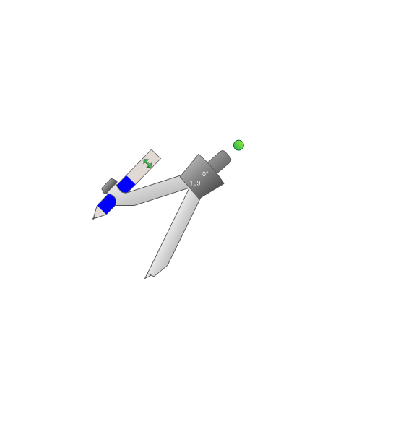
17.
18.
19.

Slide 8
20.

