Slide 1
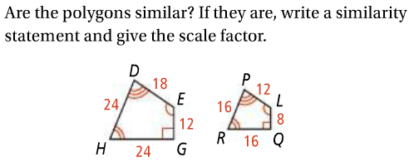
Quiz 2 Review Page 1
1.
2.

Slide 2
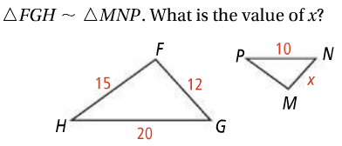
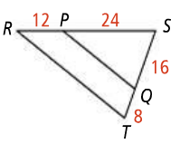
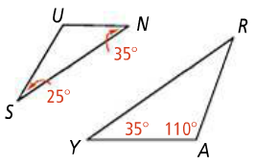
Quiz 2 Review Page 2
3.
4.
5.

Slide 3
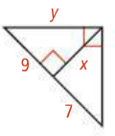
Quiz 2 Review Page 3
6.
7.
8.

Slide 4
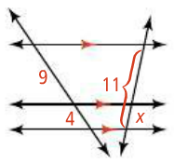
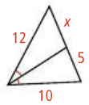
Quiz 2 Review Page 4
9.
10.
11.

