Slide 1
Make 1/3 into a whole number.
If a ratio is originally 300:1/3, what will it be after making 1/3 a whole number?

Slide 2
The sides of a triangle are in the extended ratio of 4:3:6. If the length of the longest side is 12 inches, what is the length of the shortest side?

Slide 3
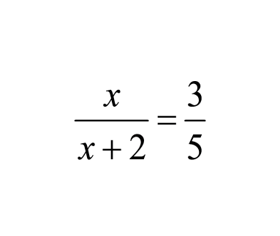

Slide 4
The scale of a map is 2 in = 24 mi. On the map, the distance between two cities is 4.5 inches. What is the actual distance?

Slide 5
What do you need to know in order to find out if two polygons are similar?

Slide 6
How do you write a similarity statement of two triangles?
How do you write a similarity statement of two of any other polygon?

Slide 7
In order to find side x, I first need to match up the corresponding ____________.
If I'm using the shortest and longest sides of a small and big triangle, how would I set up the proportion to find x?

Slide 8
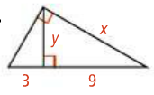

Slide 9
A 2 ft. tall mailbox casts a shadow that is 5 ft long. At the same time, a vehicle casts a shadow 20 ft long. How tall is the vehicle?

